Slide 1
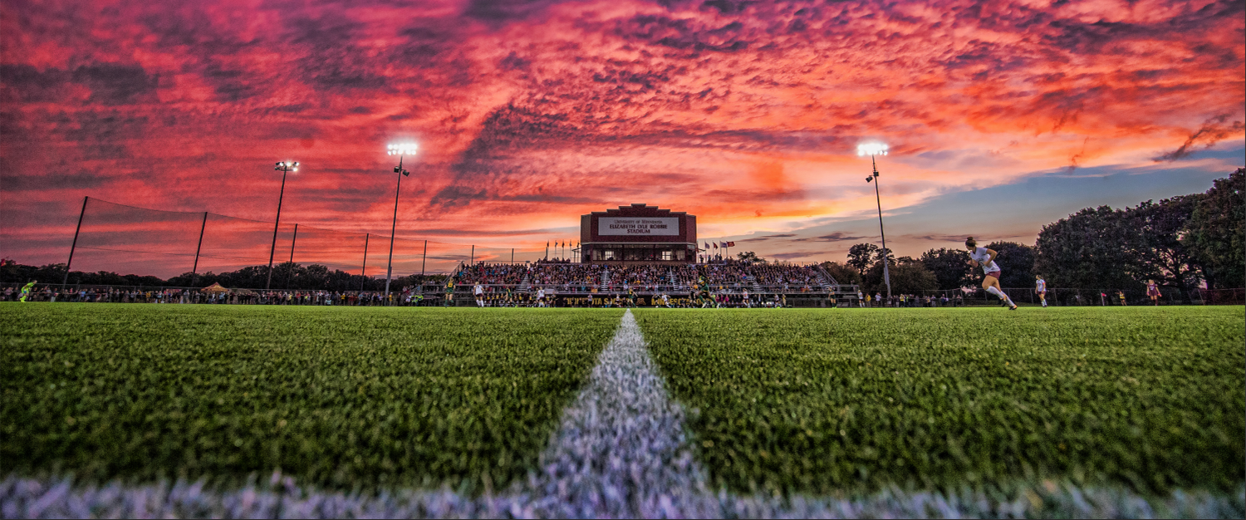
Sports Scholarship U
Oliver Diaz & Markus Just

Slide 2
Introduction
Our website provides information about what it is like to be a student-athlete and what it takes
We explain a typical day in the life of a student-athlete and what the person signing up for this can expect
We also present the opportunities a student-athlete might have after graduation

Slide 3

Business Proposal
In 2021, the National Collegiate Athletic Association generated a record US 1.16 BN in revenue from college sports
The culture of student-athletes here in America is very attracting to international students
What the student athletes are left with: great experience and interest from businesses that value this experience

Slide 4

Purpose
Introducing a huge network of successful student-athletes to American college
There can be very little information for international students in the process of landing a school in America.
This website will bring visibility and information to international students as well as assist in choosing a school that fits their liking.

Slide 5
Target Audience and Motivation
Our target audience is athletes between 16-19 years old who want to combine studies and athletics in the US after high school
They must be able to juggle traveling, training, and academics all at the same time
The visitors on our website are male or female athletes wanting to pursue their athletic dreams while still getting a stellar education
A typical visitor of the website is ambitious, likes to step out of their comfort zone, and wants to explore something different than the average student experience
Triggered by competition and enjoys a challenge

Slide 6
Examples from the Website

Slide 7
Responsive Design

Slide 8
Link to Github: https://github.com/Olie1098/CIS-5620-FinalP

